Slide 1
FOLIOS
Festival of Lights Interactions Operating System

Slide 2
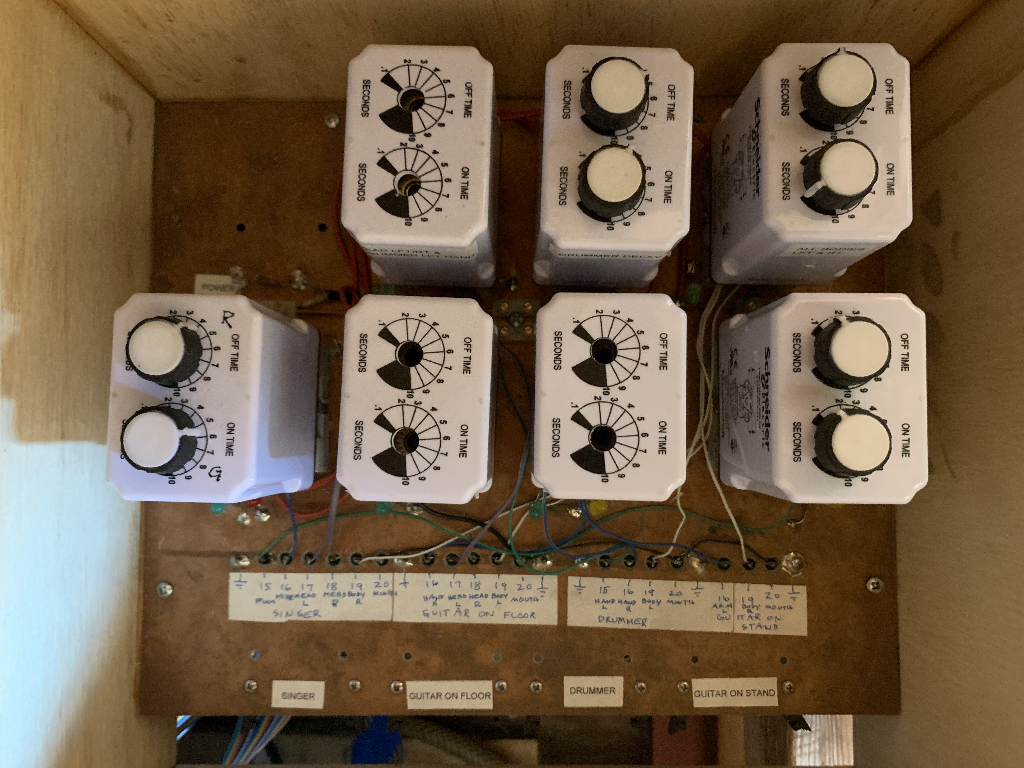
Current Controller
Animatronic band
Analog controller

Slide 3
Functional Comparison
Current
1982 analog controller board
Controls movement only
Proposed
2021 digital controller board
Integrates all media into synchronized effects across:
Audio/music
Animation/movement
Area lights
Pixel lights

Slide 4
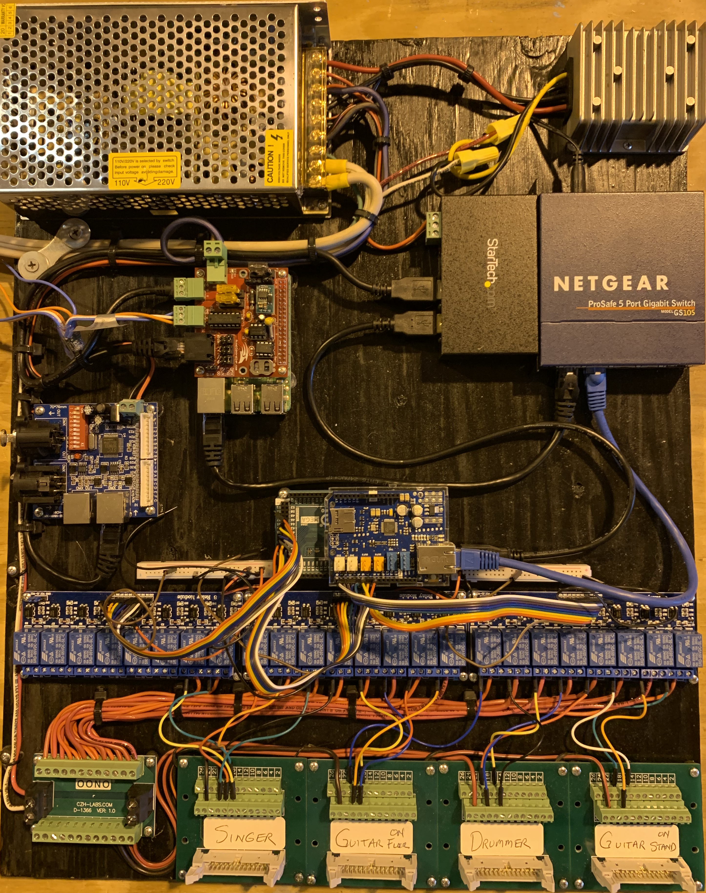
New Float Controller
“FOLIOS”
Festival of Lights Interactions Operating System
Switch
Standardized controller board
Integrates all media into synchronized effects across:
Audio
Animation
Area lights
Pixel lights
Open source project published at
https://github.com/Los-Altos-Festival-of-Lights/folios
Pi/PiCap
DMX
Arduino
Relays

Slide 5
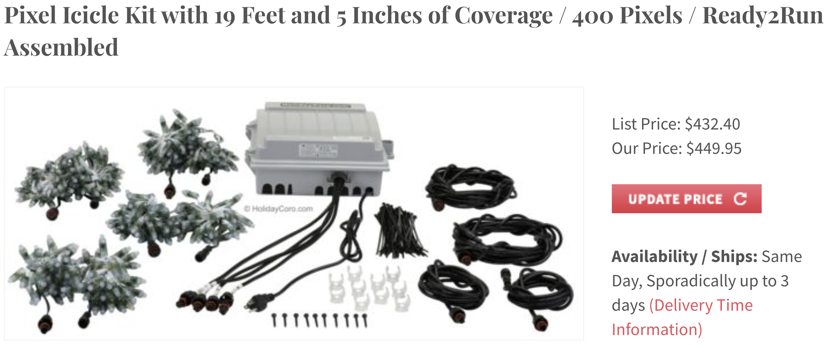
Float Controller Architecture
Speaker1
Audio
Amp
Pi + PiCap
WiFi
Xlights
Speaker2
DMX
E1.31 over ethernet
Pixel string1
Switch
Pixel string2
Sub-controllers
DMX pcb
DMX area lights
Singer
Guitar Floor
Pixel Tree
Icicles on top bar
Arduino
Drummer
https://www.holidaycoro.com/Pixel-Icicle-Kit-p/834.htm
Guitar Stand
Matrix Display
https://www.holidaycoro.com/1012-pixel-Matrix-Panel-Kit-p/781.htm

Slide 6
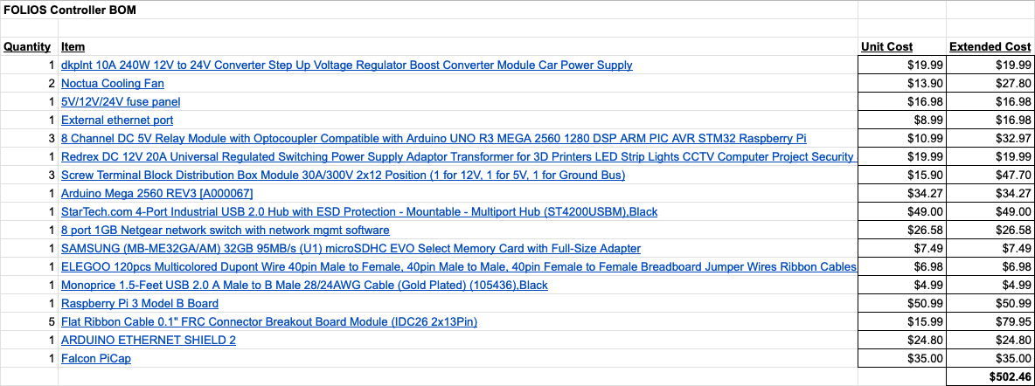
Float Controller BOM / ~$500 per Controller

Slide 7
FOLIOS VIDEOS
Festival of Lights Interactions Operating System

Slide 8
Rock Band
Float Refresh

Slide 9
Rock Band Refresh
Theme: “News Year’s Eve Holiday Party”
Elements:
Garland all round top of cage
Icicles just beneath the garland (pixel leds)
Rotating small mirrored ball in center lighted from all sides by dmx spotlights
Remove back board, replace with pixel lighted tree (same height as float)
Redesign back door
Locate controller in front box
1 large Tree + 2 small trees on back (instead of back board)
2 small trees in front
Snowdrifts around boxes, snow-erize the boxes
All round float edges Pixel underlighting
Synchronized animatronics to the song “Run Run Rudolph” by Chuck Berry (2min57sec )
Cost TBD but ~$3K (including Folios) - will detail complete budget estimate

Slide 10
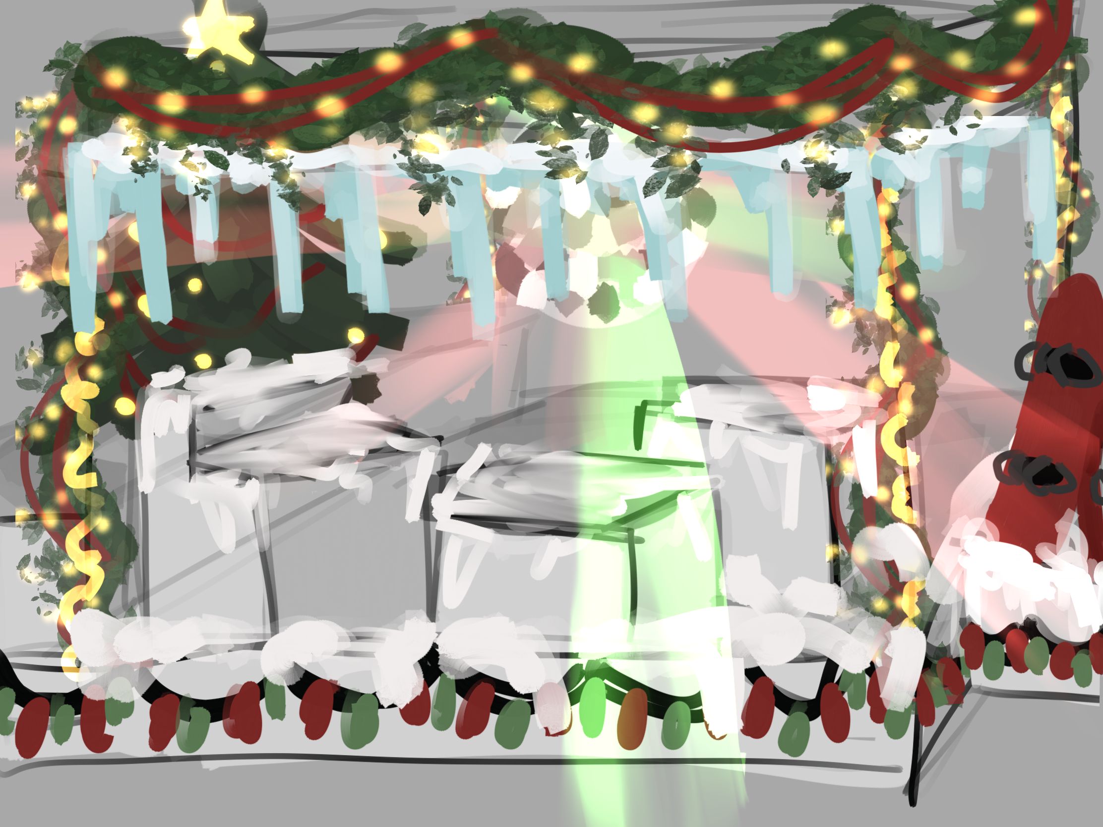
Garland +
Icicle Pixels
Mirror Ball
Tree Pixels
Rack of boards
Spot lights on Ball
Snow drifts
Arc Pixels
Pixel underlighting

Slide 11
Rock Band Refresh
Theme: “News Year’s Eve Holiday Party”
Elements:
Garland all round top of cage
Icicles just beneath the garland (pixel leds)
Rotating small mirrored ball in center lighted from all sides by dmx spotlights
Remove back board, replace with pixel lighted tree (same height as float)
Redesign back door
Locate controller in front box
1 large Tree + 2 small trees on back (instead of back board)
2 small trees in front
Snowdrifts around boxes, snow-erize the boxes
All round float edges Pixel underlighting
Synchronized animatronics to the song “Run Run Rudolph” by Chuck Berry (2min57sec )
Cost TBD but ~$3K (including Folios) - will detail complete budget estimate

Slide 12
Example Simulation
Aidan preview here

Slide 13
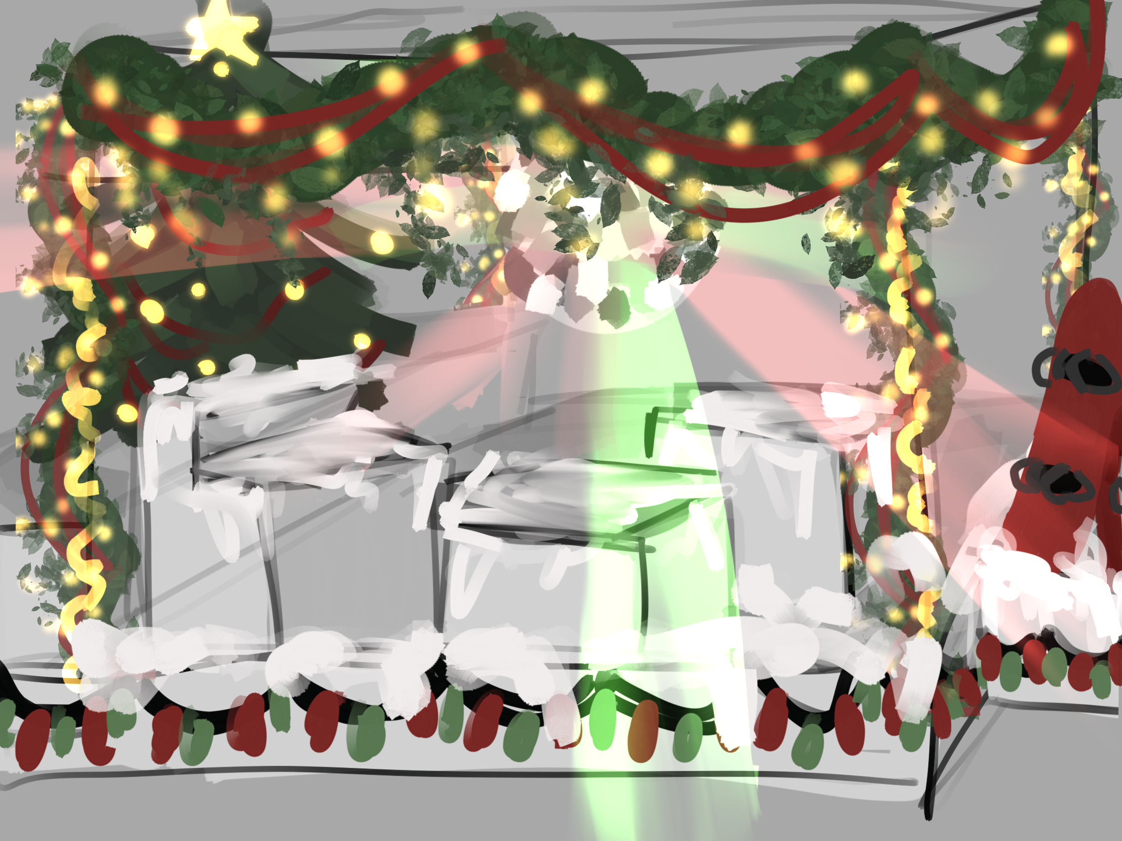
Garland Pixels
Mirror Ball
Tree Pixels
Rack of boards
Spot lights on Ball
Spot lights on Ball
Snow drifts
Arc Pixels
Pixel underlight

Slide 14
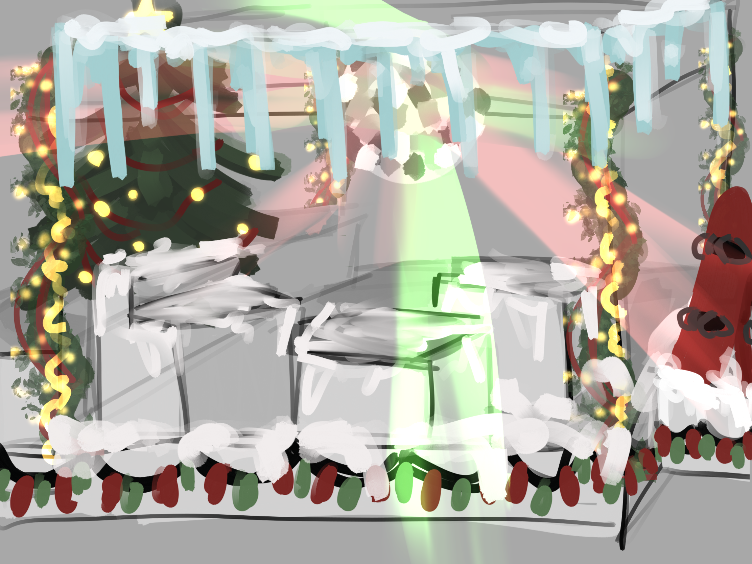
Icicle Pixels
Mirror Ball
Tree Pixels
Rack of boards
Spot lights on Ball
Spot lights on Ball
Snow drifts
Arc Pixels
Pixel underlight

Slide 15
Estimate
Icicles $450

